Slide 1


Terminal Guessing Game
Matthew Kennedy T1A3

Slide 2
Terminal App
What is it?
The application is a game designed to reduce stress and test algorithmic and critical thinking skills, pitting one player against another.

Slide 3
Terminal App
Menu selection
Update code (names)
2 Games
Leader board
Keeping records
Generating Numbers
Features

Slide 4
Terminal App
Up to 2 players fill in their names which gets stored by the app.
They compete by guessing a random number generated by the app and compare their scores on the leader board.
How it’s used

Slide 5
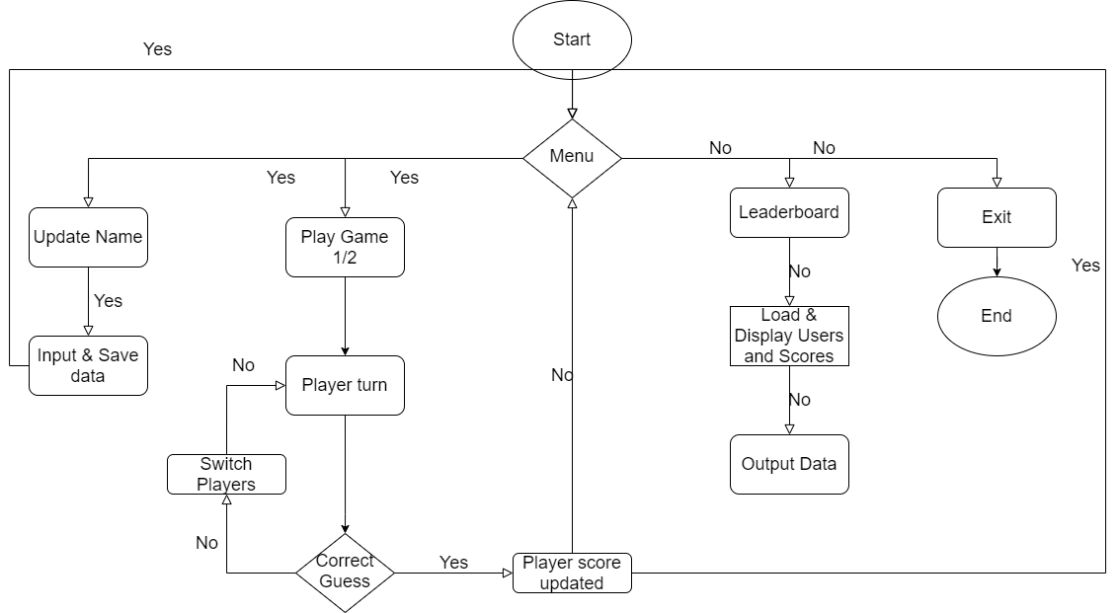

Slide 6
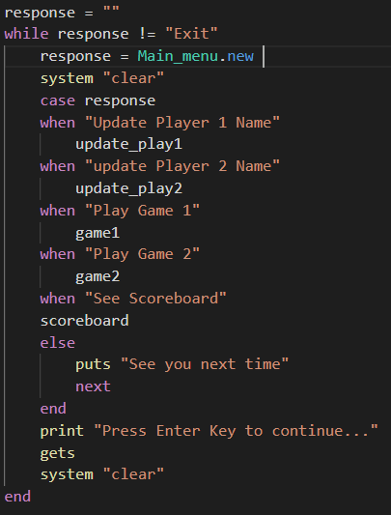
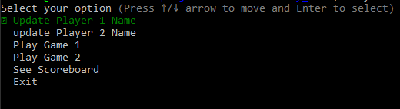
Logic of App and Code
Updating Info

Slide 7


Logic of App and Code
Updating Info

Slide 8
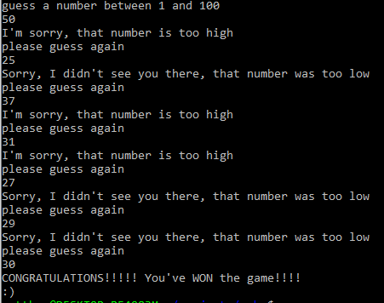
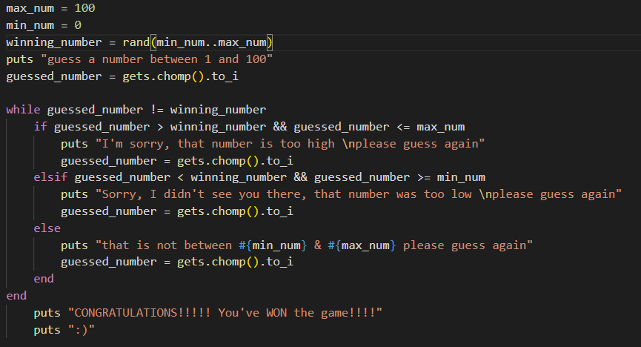
Logic of App and Code
Playing the game

Slide 9
Terminal App
Estimate and update required time for each step
Plan game logic
Create classes for:
Menu
Leader board
Users
Games
Utilise array combined with ‘tty-prompt’ for menu selection
Set values for gameplay
Utilise ‘while if’ loop to compare user input to set number and decide next steps
Save scores and update leader board
Build Process

Slide 10
Terminal App
Linking data between files/classes
Menu creation and utilising gems effectively
Determining the best logic for the game
Challenges

Slide 11
Terminal App
Make sure game is fun and rewarding but not too addictive which is a rising concern in the gaming industry as seen here http://static.nathanjwilson.com.s3-ap-southeast-2.amazonaws.com/video_game_addiction.pdf
Prevent users from cheating by averaging their scores for the leader board. (no penalty for playing less)
Ethical Issues

Slide 12
Terminal App
Overcoming difficult aspects of code
Learning new concepts
Seeing it all piece together
Favourite Parts

Slide 13
Terminal App
Overcoming difficult aspects of code
Learning new concepts
Problem Solving
Seeing it all come together
Favourite Parts

Slide 14

Thank You!
Matthew Kennedy

